Slide 1
Advanced Microelectronics Lab
amr.alaa@guc.edu.eg
C3.305 (Back office)
Sandy.abdelmalak@guc.edu.eg
C3.207

Slide 2
Introduction to Digital Design
Digital Design
ASIC
FPGA

Slide 3
ASIC
Application Specific Integrated Circuit
Designed for a specific purpose
Gates and flip-flops permanently connected
Design written in hardware description languages (Verilog - VHDL) or created from transistor level
Functional Design
Circuit Design
Physical Design
Fabrication

Slide 4
FPGA
Field Programmable Gate Array
Reprogrammed for various functions
Consists of Configurable Logic Blocks (CLBs) with programmable interconnects.
CLBs are primarily made of Look-Up Tables (LUTs), Multiplexers and Flip-Flops
Processor core inside the FPGA die
Design written in hardware description languages (Verilog - VHDL)

Slide 5
FPGA Vs. ASIC
FPGA | ASIC
Reconfigurable Circuit | Permanent Circuit
Reasonable cost | Expensive
Prototyping & Validation | Mass production
Less energy efficient | Energy Efficient
Limited Frequency | Based on technology node
Suitable for applications with upgrade | Not suitable for upgrades
Back-End design handled by tools | Back End-Design requires specialists
Not suitable for analog applications | Supports Analog Circuits

Slide 6
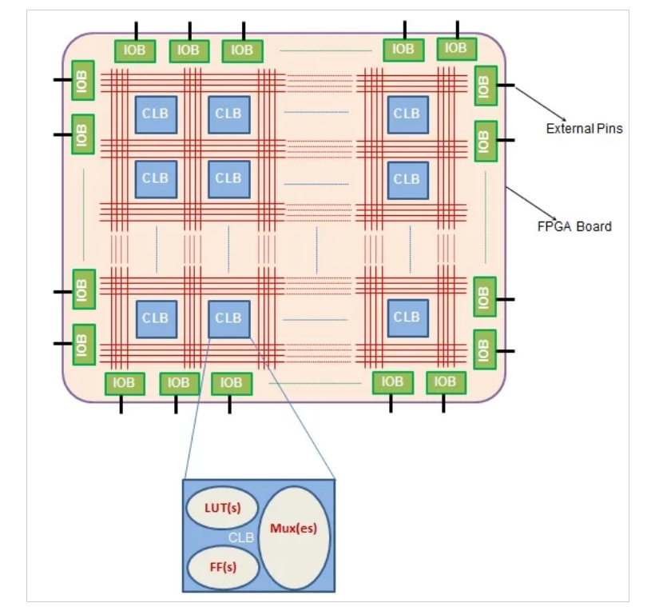
FPGA
Configurable Logic Blocks (CLBs)
Input / Output Blocks (IOBs)
Switch Matrix

Slide 7
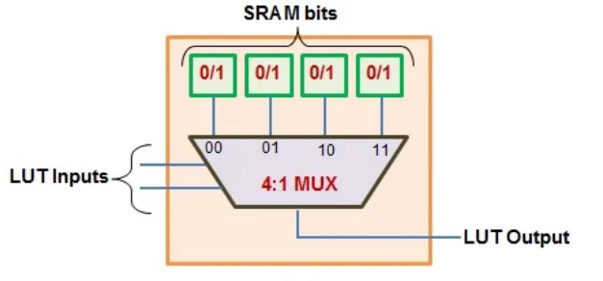
Look Up Table (LUT)
LUTs comprise of 1-bit memory cells (programmable to hold either ‘0’ or ‘1’) and a set of multiplexers
LUT with n inputs is seen to comprise of 2^{n} single-bit memory cells followed by a 2^{n}:1 multiplexer

Slide 8
Look Up Table (LUT)
At first, the output values for each combination of input variables constituting the Boolean functions are stored in the SRAM cells of the LUT.
After this, depending on the combination of input variables supplied by the user, the appropriate memory bit will appear at LUT’s output pin.
This is due to the fact that the user-provided input bits act as the select lines for the multiplexer(s) present inside the LUT(s).
SRAM cells:
Volatile
Fast

Slide 9
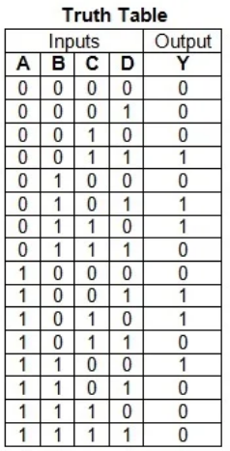
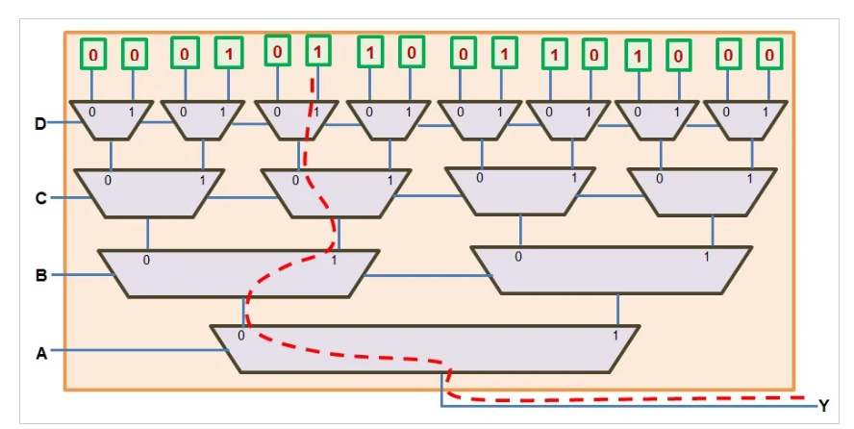
LUT Example

Slide 10
VHDL Tips
General Tips
Label all processes and concurrent assignments.
Write sufficient comments to explain the VHDL code.
Use packages for constants to make the code generic.
Use only one entity & architecture in each file.
Type INTEGER should have a range, If not they will synthesize to 32 bit.
Do not set a limit to type INTEGER that does not match the number of bits.
Example 1:
signal test : integer; -- range is 32 bits by default
Example 2:
signal test : integer range 0 to 12; -- 4 bits are assigned by default so up to 15

Slide 11
VHDL Tips
Clocks and Reset
Define Clocking strategy
Clock Frequency – Timing constraints
Clock Gating
Multiple clock domains and synchronizations
Reset Signals
Do not depend on signal Initialization
Asynchronous reset

Slide 12
VHDL Tips
Process
Concurrent statement with sequential statements that execute in series
A process must contain either a sensitivity list or wait statements. However, wait statements are not synthesizable
Combinational process → No clock signals & add all inputs/ signals
Sequential process → Reset & Clock signals (for asynchronous reset) and Clock only (for synchronous reset)
Do not use multiple clocks and don’t mix synchronous and asynchronous designs in the same process

Slide 13
VHDL Tips
Combinational Logic
Incomplete assignments create latches: Latches are created when you create a combinational process or conditional assignment (in VHDL) with an output that is not assigned under all possible input conditions.
In Case Statements: All cases must be covered (same for if conditions)
Combinational Processes must not contain feedback [avoid combinational loops]
Sequential Logic
Clocked processes with a sensitivity list must have only the clock and any asynchronous control inputs in the sensitivity list.
All Registers must be synchronized with the same Clock

Slide 14
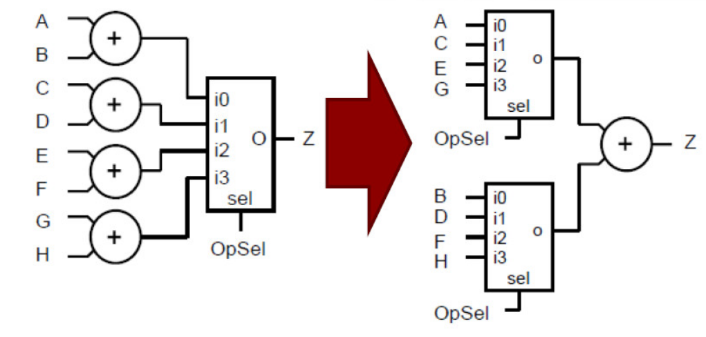
VHDL Tips
Efficient Code → Area Optimization
Process (OpSel,A,B,C,D,E,F,G,H) begin Case OpSel is when "00" => Z <= A + B ; when "01" => Z <= C + D ; when "10" => Z <= E + F ; when "11" => Z <= G + H ; when others => Z <= ‘0’ ; e﻿nd Case ; end Process ; | X <= Mux4(OpSel, A, C, E, G) ; Y <= Mux4(OpSel, B, D, F, H) ; Z <= X + Y ;

Slide 15
VHDL Tips
For loops Vs. Process statement
For loops could be used in test-bench
For generate → Not driven by a clock and not sequential
Process(……) Begin For (……………………..) …………………….. End loop; End process; | Process(……) Begin If (……………………..) …………………….. End If; End process;

Slide 16
VHDL Tips
Use "Named Signal Mapping" instead of "Ordered Mapping" in component instantiation
Nominal Port map | Positional port map
-- Instantiate Half Adder half_addr_inst: half_addr port map ( a => a1, b => b1, sum => s1, c => c1 ); | half_addr_inst: half_addr port map ( a,b,sum,c);

Slide 17
VHDL Tips
Leaving Unused Ports 'open'
-- Instantiate Half Adder without using carry signal half_addr_inst: half_addr port map ( a => a1, b => b1, sum => s1, c => open);
The synthesis tool will remove any logic inside of half_adder that is used to drive the signal c, since it is not being used by the higher-level module

Slide 18
VHDL Tips
Signals Vs. Variables:
Variables can only be used inside processes, signals can be used inside or outside processes.
Any variable that is created in one process cannot be used in another process, signals can be used in multiple processes though they can only be assigned in a single process.
Variables need to be defined after the keyword process but before the keyword begin. Signals are defined in the architecture before the begin statement.
Variables are assigned using the := assignment symbol. Signals are assigned using the <= assignment symbol.
Variables that are assigned immediately take the value of the assignment. Signals depend on if it's combinational or sequential code to know when the signal takes the value of the assignment.

Slide 19
VHDL Tips
Useful Links:
VHDL Conversions: https://www.nandland.com/vhdl/tips/tip-convert-numeric-std-logic-vector-to-integer.html
Unused Signals: https://www.nandland.com/vhdl/tutorials/dealing-with-unused-signals.html
Arrays: https://www.nandland.com/vhdl/examples/example-array-type-vhdl.html
Package: https://www.nandland.com/vhdl/examples/example-package.html
Generic: https://www.nandland.com/vhdl/examples/example-generic.html

Slide 20
Thank You
If you have any questions please contact me through email or join the office hours
amr.alaa@guc.edu.eg
Do not hesitate to send me any feedback regarding the tutorials

